Slide 1
Robotics Project
Salvatore Saputo, Deuce Lee, David Vozzo

Slide 2
Member roles
Sal - Requirements tables, Algorithms, sensor data diagram
David - Block code, test tables
Deuce - Flowchart, staffing plan
System design doc, Gantt Chart, and video was done by all team members

Slide 3
Challenges Faced
Getting all group members together
Busy schedules, not planning accordingly
Access to the room
We had to wait a few times to get the room because there were either other groups working on their project or there were other classes going on.
Trial and error with the block code
Speed, angle, and time
Inconsistency of the robot
It seemed that we could run the same code multiple times and each time was a different outcome
Objects in the room
Chairs, desks, outlets, bottles, and ramps
Charging Robot

Slide 4
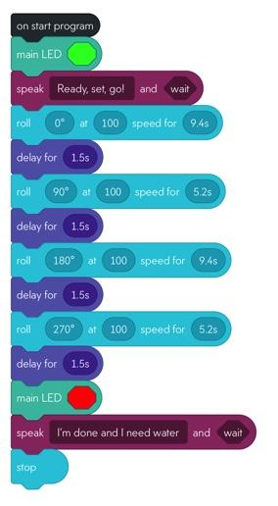
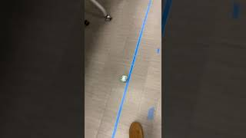
Sprint 1 Endurance

Slide 5
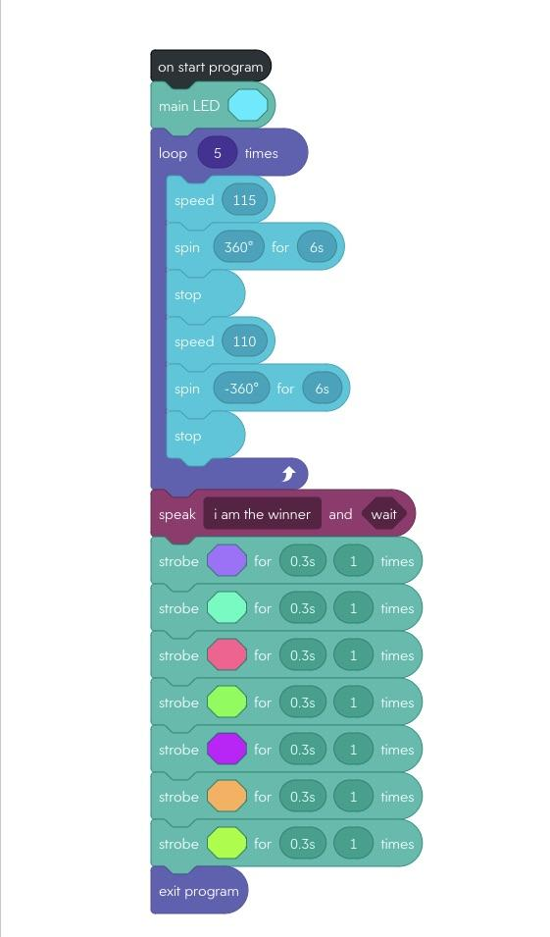
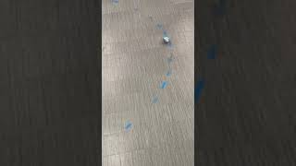
Sprint 2 Accuracy

Slide 6
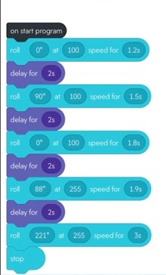
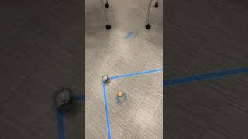
Sprint 3 Agility

Slide 7
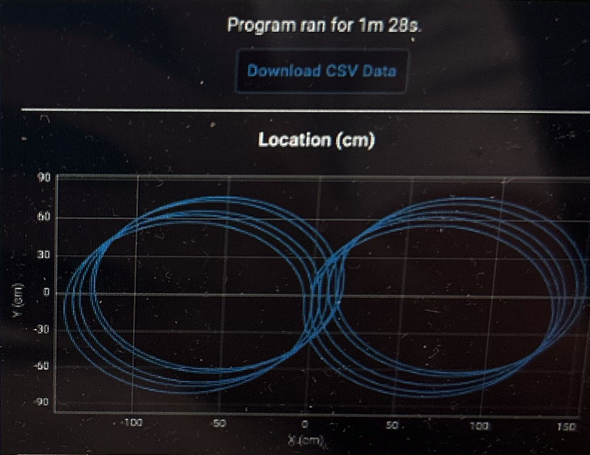
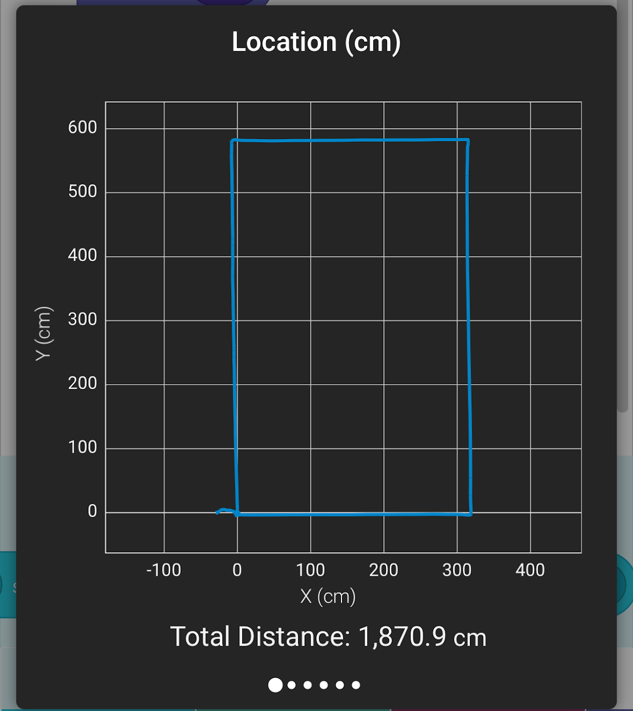
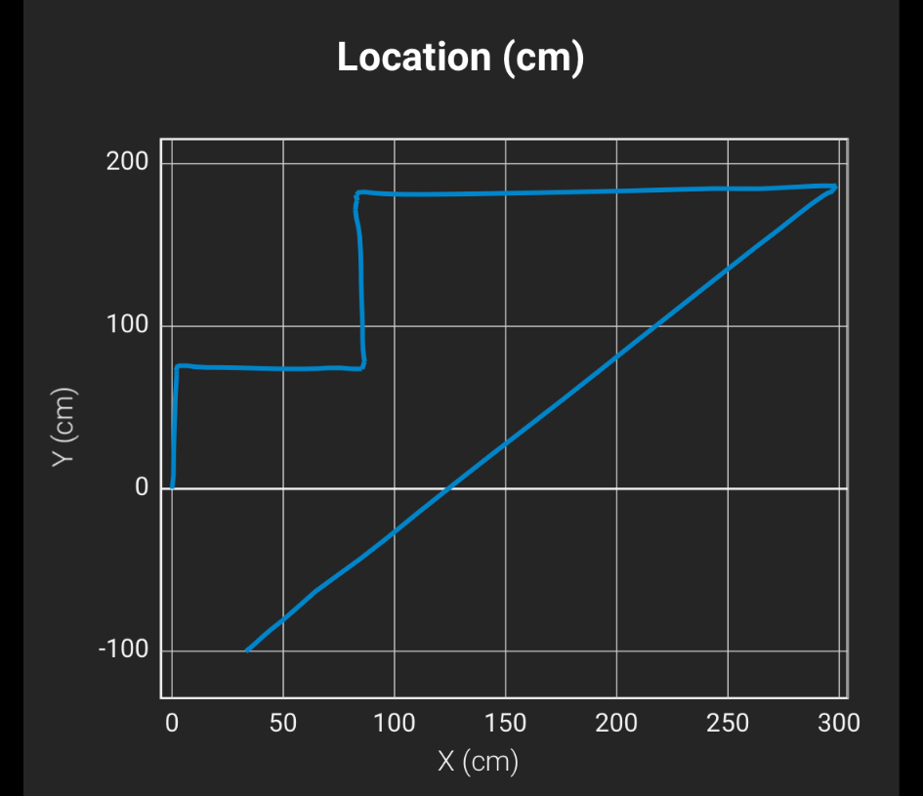
Sensor data

Slide 8
Changes we would make
Organization
Planning around our schedules
Focusing on system design document
We made easy mistakes on our flowchart by putting the wrong information into it
This would have saved us a lot of time
Upload videos to youtube before submitting
The files were too big to work in the Github

Slide 9
What we learned
Collaboration
Being able to work well with your teammates is very important, for our group, everyone had very busy schedules so we had to compensate when one person couldn’t make it sometimes. Also planning proved to be very important and it made the overall process easier.
Attention to detail
We faced a lot of small issues with code or missing some key steps when it came to planning. So we needed to really lock in and think ahead and list out every step that we were going to do
Patience
We had to express a lot of patience, from waiting for the test room, figuring out everyone's schedule and being able to work around it, and just overall going through trial and error with the whole project

